Slide 1

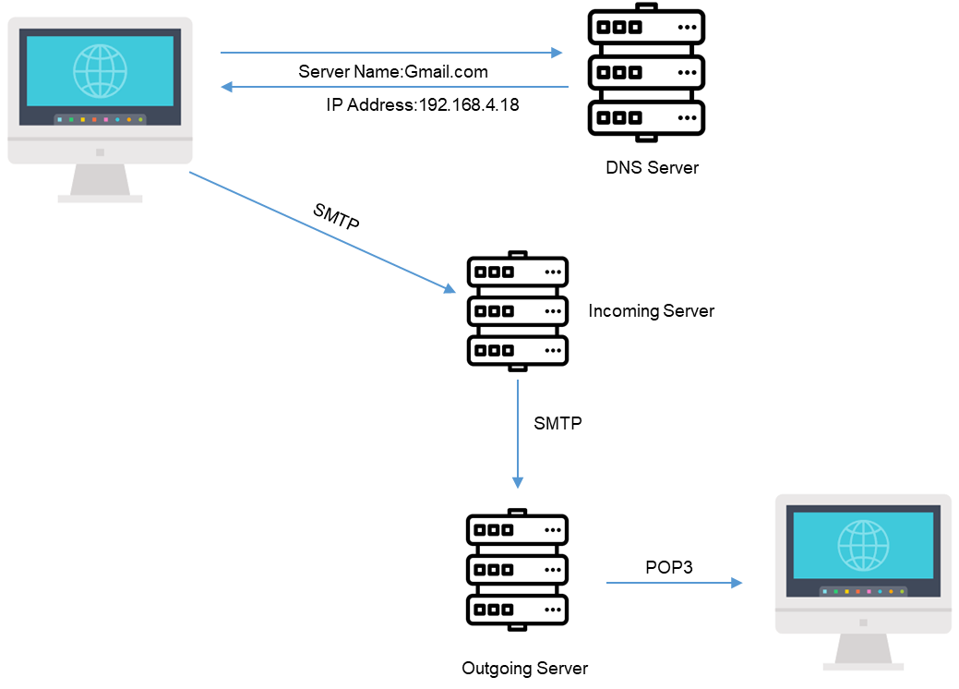
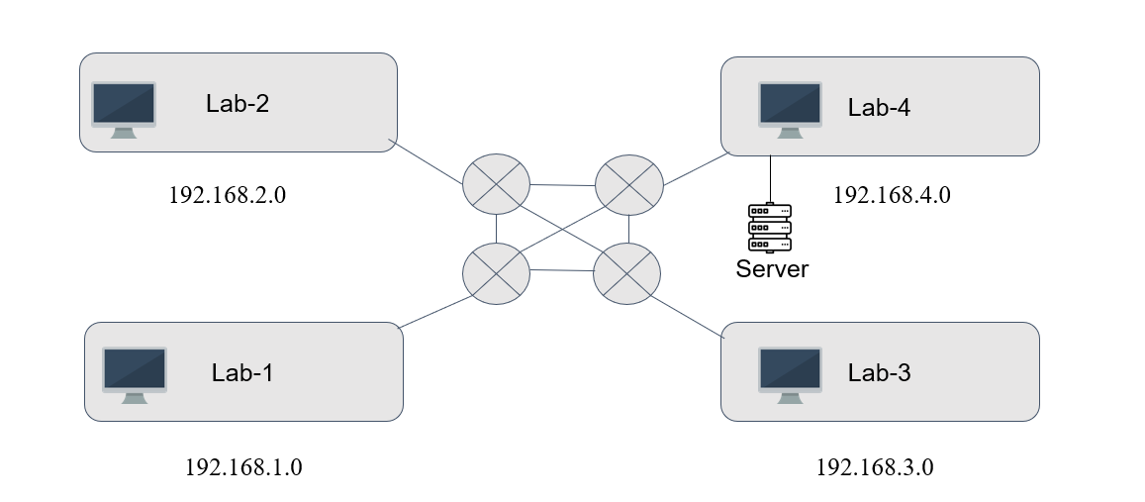

Setting Up Building Network
Achint Sathoo | Aryan Sharma | Pranoy Bhan | Kavya Dhar
2020A1R132 | 2020A1R133 | 2020A1R114 | 2020A1R112
Abstract
Mail Service Architecture
❏In this project we are setting up network in 4 Labs so that each lab can communicate with each other easily.
❏Here each lab is on different network, and we are connecting different network using router and using RIP protocol to route the packets.
❏Also covering both wired and wireless connection in a LAN which is established within different labs. Here each PC in a lab can request the service like SMTP service from the server.
Networking Device Used
1.Router
2.Switch
3.Wireless Access Point
Connecting Wire Used
1.Straight-Through Cable
2.Cross-Over Cable
3.Serial DCE Cable
A mail server architecture in a computer network connected locally in a network of labs typically includes the following components:
SMTP (Simple Mail Transfer Protocol) server:
This is the main component of the mail server architecture that hand les the sending and receiving of emails. It uses the SMTP protocol to communicate with other mail servers and deliver emails to the correct recipients.
POP3 (Post Office Protocol version 3) server:
This server handles the retrieval of emails from the mail server by client devices such as laptops and smartphones. It uses the POP3 protocol to communicate with the client devices and retrieve the desired emails.
3.Email client software:
This is the software installed on the client devices that allows users to access their emails and perform various actions such as reading, sending, and deleting emails.
4.Mail store:
This is the database where all the emails are stored on the mail server. It is typically divided into different folders for incoming, outgoing, and deleted emails.
5.Network infrastructure:
This includes the local area network (LAN) and the internet connection that connect the mail server and client devices in the network of labs.
6.Security measures:
These include firewalls, antivirus software, and encryption protocols to protect the mail server and client devices from cyber threats and unauthorized access.
End Devices Used
1.PC
2.Server
Network Structure
In this network structure, each lab is connected to the other labs with the help of four routers using serial DTE (Data Terminal Equipment) wires.
The routers are networking devices that connect the different labs and allow the computers in each lab to communicate with each other and access the internet.
The serial DTE wires are used to connect the routers together and establish a communication link between them. These wires transmit data using a serial communication protocol that allows data to be transmitted one bit at a time.
The computers in each lab are connected to the local router via Ethernet cables or wireless connectivity.
The local router is responsible for routing data between the computers in its lab and the other labs via the serial DTE wires.

